Slide 1
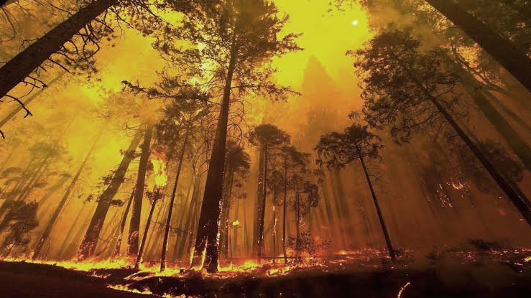
FOREST COMBUSTION RECOGNITION
USING AI
SMART BRIDGE-REMOTE SUMMER INTERNSHIP PROGRAM
DEVELOPED BY : SANJANA RAJESH REVANKAR
C V YASHASWINI
SPANDANA K
NS SHRAVANI
NEHA S

Slide 2
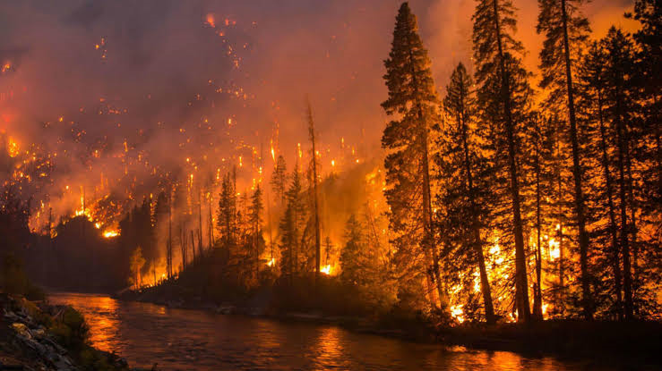
TABLE OF CONTENTS
Introduction
Purpose
Block Diagram
Flow Chart
Software Designing
Experimental Investigation
Advantages and Disadvantages
Conclusion

Slide 3
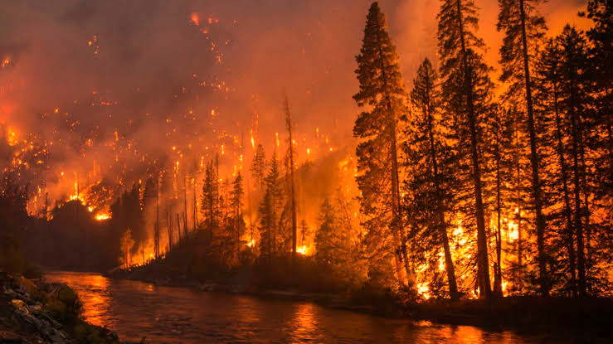
INTRODUCTION
Forests are the protectors of earth's ecological balance. But with climate change raising temperatures, wildfires have been a growing concern for many countries around the world. Fire related disasters are the most common type of Emergency situation which requires thorough analysis of the situation required for a quick and precise response and forest fire is one of those disasters which is usually observed when it has already spread over a large area, which becomes uncontrolable and its stoppage becomes impossible.
The objective is to detect the fire as fast as possible and early notification to the fire units is vital.Fire Detection in most places employs equipment like temperature detectors, smoke detectors, thermal cameras etc. which is expensive .
But,after the advent of advanced image processing and computer vision techniques, detection of fire may not require any equipment other than cameras.
Our approach is to employ state-of-the-art CNNs to distinguish between images that containing fire and images that do not and build an accurate fire detection system. To make these models more robust, we use a custom-made image dataset containing images with numerous scenarios.

Slide 4
PURPOSE
Monitoring of the potential risk areas and an early detection of fire can significantly shorten the reaction time and also reduce the potential damage as well as the cost of fire fighting
Our aim from the project is to make use of pandas, numpy libraries from python to extract the libraries for machine learning for the forest fire reconization.
Secondly, to learn how to build model using ImageDataGenerater hypertune the forest with and without fire images using Convolution neural netwrok(CNN) machine learning algorithm.
And in the end, to predict whether the image is with fire or not, using video analysistechnique of combining the predictions from machine learning algorithms and giving the alert message to the email address.

Slide 5
BLOCK DIAGRAM
Data Collection and Its pre-processing
Import Imagedategenerat-or, apply it to train and test set
Train and test the model and optimise it
Save the model
Configure the learning process
Initialize the model and add layers
Video streaming
Send alert message when fire is detected

Slide 6
FLOW CHART
Start
Read the video(streaming) or image
Predict the class
(Forest, With_fire)
No
If fire detected
Yes
Send an Alert Email
Stop

Slide 7
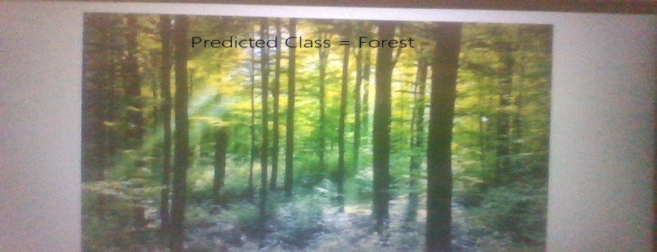
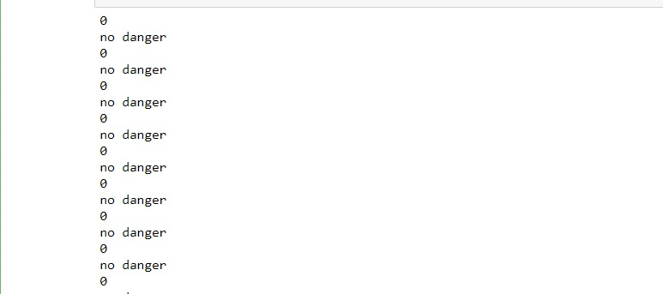
Results
• In this project we created a dataset with collection of forest images with fire and without fire. Those collection of forest dataset images are given below
• Next step is to build model. After that video streaming will detects the images. Those collection of forest outputs are given below
(a)Predicted as forest without fire
(b)Program output when no fire was detected

Slide 8
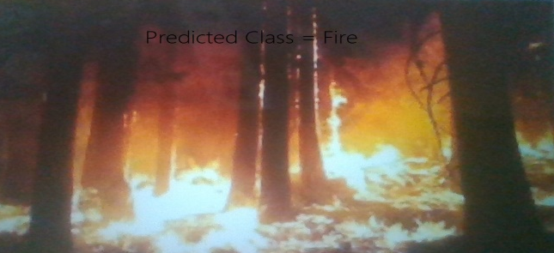
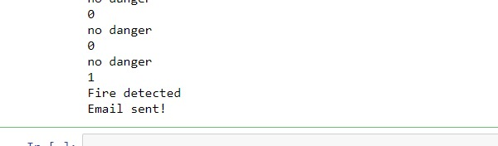
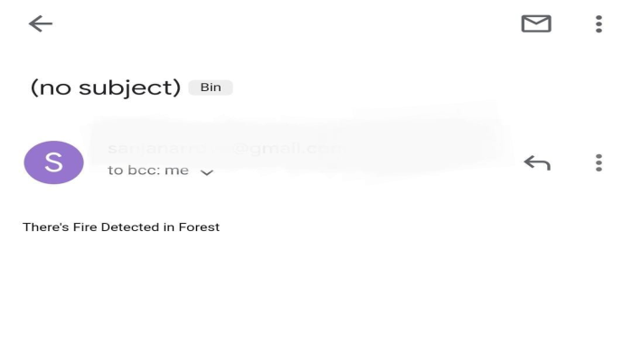
Predicted as forest with fire
Program output when fire was detected
Email was sent

Slide 9
ADVANTAGES
Less expensive.
Low consumption.
Reduce death rate.
Simple, fast and easy to implement.
Reduces significant economic impact on government budgets every year.
Reduces the pollution of the environment.
DISADVANTAGES
Determining climate conditions, daily temperature differences, Seasonal normal temperature values etc.. are problematic.
User can make mistakes while typing a message format.
Moreover, each battery needs to be changed periodically, but capturing the MBS to do this is not easy.
Network issues

Slide 10
CONCLUSION
This project proposes an eﬀective forest ﬁre detection method using CNN and max pooling operation techniques including movement containing region detection based on color segmentation. The performance of the proposed algorithm is tested on data set consisting of forest with and without ﬁre images from the internet. TP-rate and TN-rate were calculated. The results show that the proposed algorithm achieves good detection rates. These results indicate that the proposed method is accurate and can be used in automatic forest ﬁre-alarm systems. For future work, the system could be improved by using a combination of rules of diﬀerent color spaces. However, the challenge is selecting the right rules from diﬀerent color spaces to build the method.

Slide 11
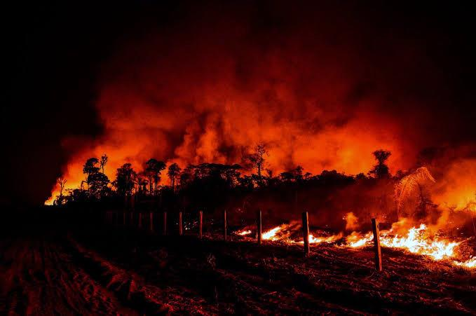
THANK YOU

